Slide 1
Deep Learning on AWS Himanshu Dave
Notes:
INTRODUCTION :my name is himanshu Dave , I work as Sr. Consultant in Neudesic 's data and analytics practice , work out of NY office . My background is in cloud , data engineering and architecture . Today I am going to present you implementation of deep learning stack on aws . This solution is develop specifically for Kaggle data science bowl .
In next 10 min will give you short presentation on how we leverage the cloud-native deep learning technologies to and leverage AWS cloud. This solution will be available FREE in aws market place with 1 click deployment . making Complex technology is simple and easy..

Slide 2
Neudesic Deep Learning Stack On AWS
Objective is to deploy custom build in-depth deep learning applications, cloud native DL stack lets client run complex algorithms where data is stored and analyzed.
It offers a family of intelligent services that provide cloud-native machine learning and deep learning technologies to address Client AI based data insight in most efficient way.
Client Launch instances of the AMI, pre-installed with open source deep learning frameworks (Python scientific suite, TensorFlow ,CUDA ,CNN and Keras ), to train sophisticated, custom AI models, experiment with new algorithms, and learn new deep learning skills and techniques; all backed by auto-scaling clusters of GPU-based instances.
Notes:
Slide 2 : what is primary objective of creating such a stack , what it offers to users , how it make life simple for developers to create and run deep learning algorithm quick and easy .
Details: Think in terms of cloud and Micro Serviced based implementation .

Slide 3
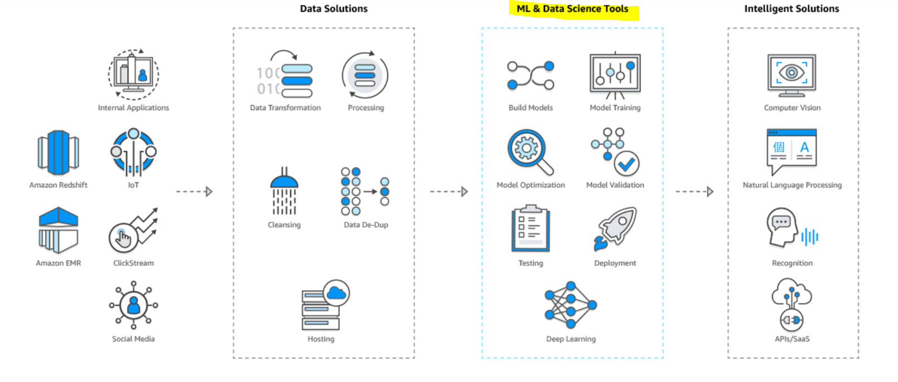
ML and Data Science Tools
Notes:
Slide 3 : How do we fit in to overall data analytic platform ?
This is end to end generalized data processing and analytic platform, we fit exactly where high value curated data is taken in and process by deep learning networks. Value addition is Huge as critical insights that client is looking for is created right on this layer. Client facing application use this models and serve to visualization tool.

Slide 4
Technical stack Details
Install the Python scientific suite—Numpy and SciPy—and make sure you have a Basic Linear Algebra Subprogram (BLAS) library installed so your models run fast on CPU.
Install two extras packages that come in handy when using Keras: HDF5 (for saving large neural-network files) and Graphviz (for visualizing neural--network architectures).
Make sure your GPU can run deep-learning code, by installing CUDA drivers and cuDNN. Use CUDA 8 and cuDNN 6 for gpu to work.
Install a backend for Keras: TensorFlow, CNTK, or Theano.
Install Keras. Gitclone the COCO and Mask_RCNN library .
Notes:
Slide 4 : big picture - The process of setting up a deep-learning workstation is fairly involved and consists of the few steps . GO THRU SLIDES and last tell them about where to find it. - see appendix for install or refer to detail process doc on Timu.

Slide 5
AWS Deployment
Primary Fulfillment method is via Amazon Machine Image ( AMI)
Product Overview web page is created
Template Components are EC2, EBS , ECS services.
Usage instruction is documented – Getting started Guide , demo
Standard end user license is agreed on as this is Proprietary IP .
Support Forum can be created but not offered at this time
Usage cost are AWS primary EC2- usage charges ,start with 1$/hr on demand or can be optimized .
Notes:
Slide 5 : How it is deployed to AWS and cost of using It and how users are supported for any issues .
GO thru slides and emphasize how cost are contained .
Deployment Methods and service offering . AMI can be deployed GPU series ec2 instances
Start with PX or GX –
Explain what services will be used
Talk about licenses , as everything is open sourced. Right to use not to distribute , Neudesic IP

Slide 6
Jupyter Notebook Integration
A Jupyter notebook is a web app that allows you to write and annotate Python code interactively. It’s a great way to experiment, do research, and share what you’re working on.
The better setup is to run deep-learning Jupyter notebooks on an AWS GPU instance and editing the notebooks from anywhere browser
Configure the setup to use Certificate , SSL .
Configure in AWS security group , Forward the ports .
Kick start the notebook during boot abd Serve the notebook locally
Intergration with aws tools like Sagemaker , it will create end points for user .
Notes:
Slide 6 : next slide will talk about How users are exposed to Software ?
what users need in order to use it . ?
Primary method is web based jupyter notebook using python3 at this time , this is interactive methods , for batch process use the ssh to instance and run the python script. Or SBT tool. There is github integration possible or access thru the
Sagemaker or other aws tools .

Slide 7
Operational Aspects
Shared Responsibility Model
Monitor by using Cloud watch and SNS
Security is defaulted to nedudesic adopted aws standard
No specific changes are requested at IAM policy or group level .
EC2 and ECS charges are monitor closely
AWS instance Auto scheduler can be used for cost saving
Follow AWS best DevOps Practices .
Notes:
Slide 7 : last one will go over the operational aspects .
Scaling Monitoring , administration and continuous development process.
There is no changes proposed on security or IAM model.

Slide 8
APPENDIX - Useful Commands
A.1. INSTALLING THE PYTHON SCIENTIFIC SUITE
sudo apt-get install build-essential cmake git unzip \ pkg-config libopenblas-dev liblapack-dev
sudo apt-get install python-numpy python-scipy python- matplotlibpython-yaml
sudo apt-get install libhdf5-serial-dev python-h5py
sudo -H pip3 install pydot-ng ( USE pip3 and -H)
$ sudo apt-get install graphviz
$ sudo pip3 install pydot-ng
A.2. SETTING UP GPU SUPPORT
wget http://developer.download.nvidia.com/compute/cuda/repos/ubuntu1604/x86_64/cuda-repo-ubuntu1604_9.0.176-1_amd64.deb
fetch keys and install
$ sudo dpkg -i cuda-repo-ubuntu1604_9.0.176-1_amd64.deb$ sudo apt-key adv --fetch-keys http://developer.download.nvidia.com/compute/cuda/repos/ubuntu1604/x86_64/7fa2af80.pub$ sudo apt-get update$ sudo apt-get install cuda-8-0
install cuDNN - use sftp
Register for a free NVIDIA developer account (unfortunately, this is necessary in order to gain access to the cuDNN download), and download cuDNN at https://developer.NVIDIA.com/cudnn
sudo dpkg -i dpkg -i libcudnn7_7.0.5.15-1+cuda9.1_amd64.deb
sudo -H pip3 install tensorflow-gpu
use w/o gpu does not see, pythin is using gpu fies
install keras from github and COCO and mask_RCNN . – got clone weblink USE TIMU INSTALL DOCUMENT .

